Slide 1

Capstone - Final Presentation
TITLE : Weekly Sales Forecasting
Submitted by : Megha Jain
Prapthi S Jain
Karthik S
Sriram M
Mohammad Arsalan Siddique

Slide 2
PROBLEM BACKGROUND
Retailers plan to insure success or maximum profit by learning about the factors that affects their sales and in what measure. Big organizations and retailers around the world, such as the one this work is based on, Walmart Stores, Inc., try to maximize the profit by providing maximum customer satisfaction in all geographical locations to maintain the standards of the stores.
Retailers have to manage resources wisely to maximize the profit while at the same time minimizing the cost. Retailers fail to gauge market potential at the right time. When there is a sudden spike in sales and the retailers are caught off-guard there might not be enough stock or enough staff to meet the customer needs thus losing potential sales.

Slide 3
PROBLEM DEFINITION
Predicting future sales for a company is one of the most important aspects of strategic planning. We wanted to analyze how internal and external factors of one of the biggest companies in the US can affect their Weekly Sales in the future.
This module contains complete analysis of data, includes time series analysis, identifies the best performing stores , performs sales prediction with the help of non-linear regression models.
The regression models assumed to be used are Decision Tree, Random Forest, XG-Boost, Bagging, etc., This final project report comprises of data understanding, data visualization, Feature engineering, EDA, Time Series Analysis, OLS and non-linear regression machine learning models.

Slide 4
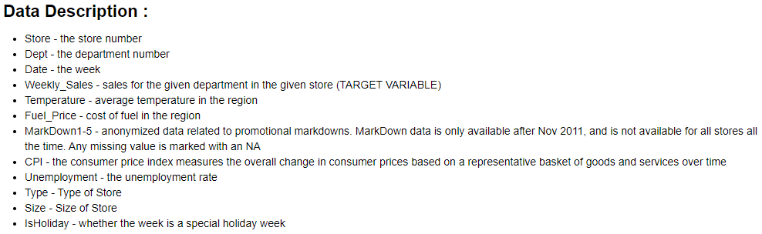
DATASET AND DOMAIN
The data is from Retail domain and is related to Walmart and are provided with historical sales data for 45 stores located in different regions - each store contains a number of departments. The company also runs several promotional markdown events throughout the year.
These markdowns precede prominent holidays, the four largest of which are the Super Bowl, Labor Day, Thanksgiving, and Christmas. The weeks including these holidays are weighted five times higher in the evaluation than non-holiday

Slide 5
WORK FLOW
Data Understanding
Data Cleaning and Preprocessing
Feature Selection
Model Building
Further Improvement

Slide 6
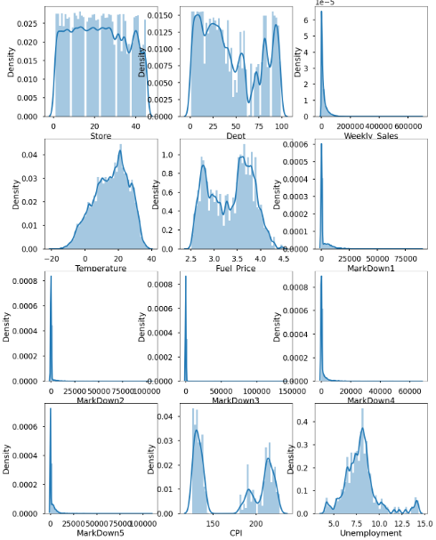
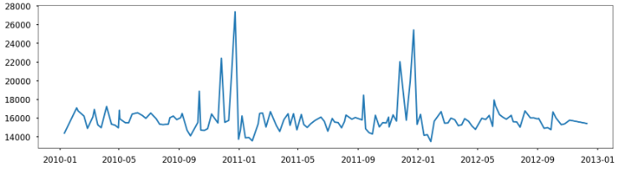
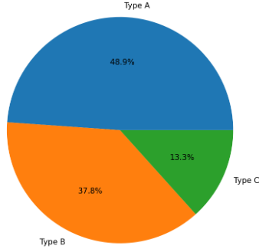
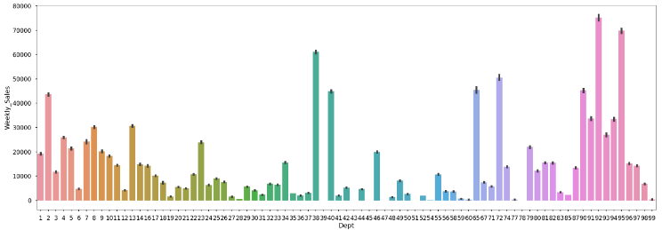
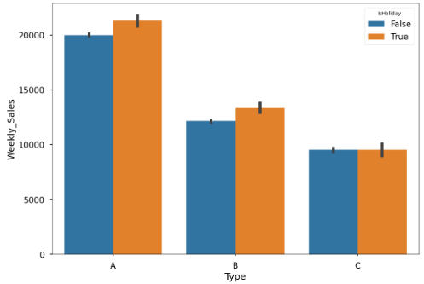
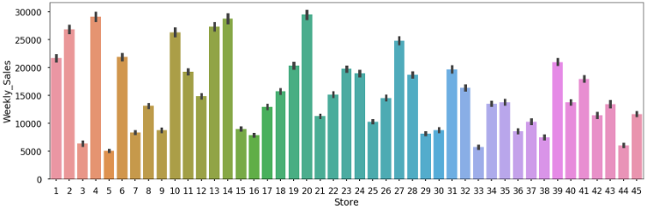
EDA: Data Distribution

Slide 7
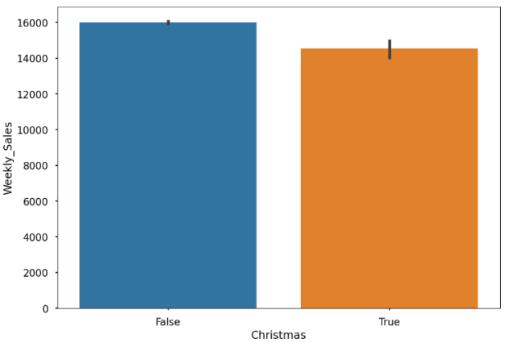
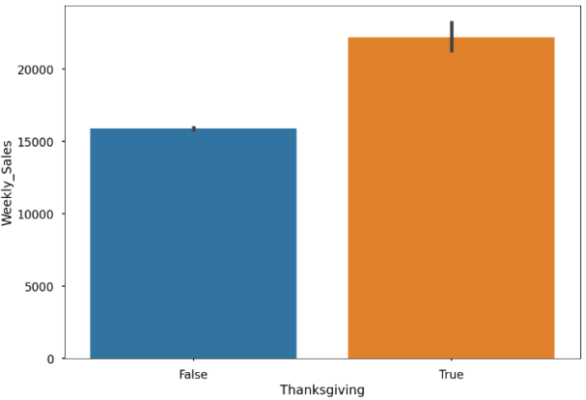
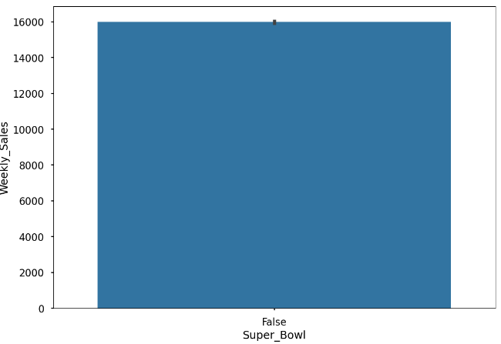
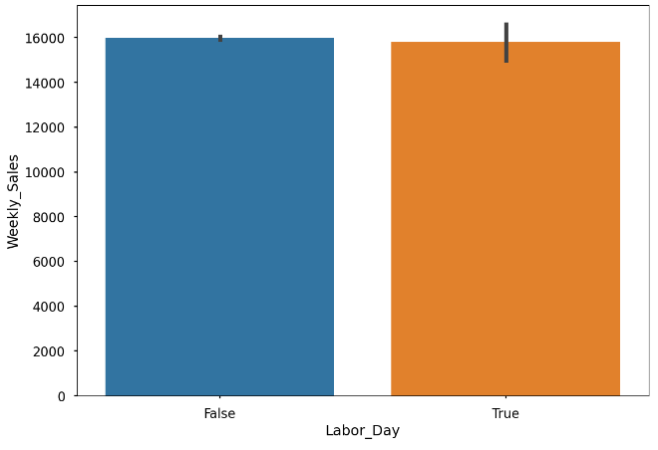
FEATURE ENGINEERING & DATA PREPROCESSING
Feature Engineering:
We want to see differences between holiday types. So, I create new columns for 4 types of holidays and fill them with boolean values. If date belongs to this type of holiday it is True, if not False. (Super Bowl, Thanksgiving, Christmas, Labour Day)
Label encoding :
Label Encoding is a popular encoding technique for handling categorical variables. In this technique, each label is assigned a unique integer based on alphabetical ordering.
Label Encoder labels different level of the categorical variables with values between 0 and n-1, where ‘n’ is the number of distinct categories.
Power Transformation :
It is a data transformation technique used to stabilize variance, make the data more normal distribution-like, improve the validity of measures of association (such as the Pearson correlation between variables), and for other data stabilization procedures.

Slide 8
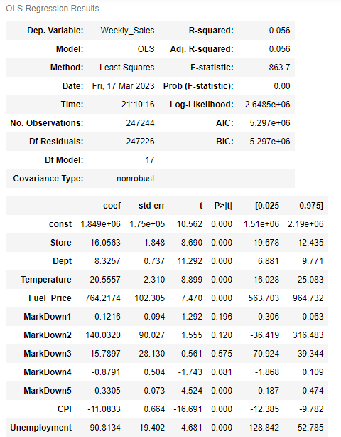
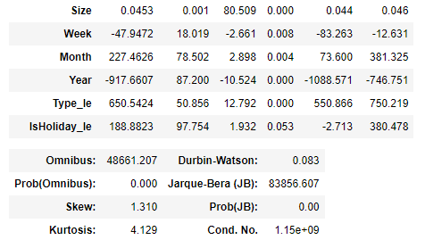
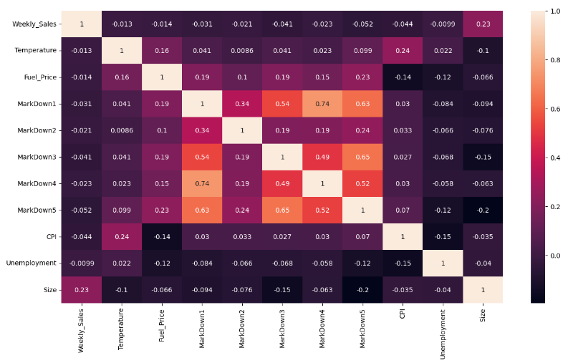
CORRELATION MATRIX, OLS MODEL (Non-Linear Data)
Correlation heatmaps are a type of plot that visualize the strength of relationships between numerical variables. Correlation plots are used to understand which variables are related to each other and the strength of this relationship.
INFERENCE:
Still the r square is 5%
We can observe that the OLS model is having very high multicollinearity as its condition number is very high(1.14e+09)
Since value of Durbin-Watson number is much below 2, it shows our data has positive Autocorrelation
Low value of F(Statistic) indicates that our linear model does not provide best fit line to our data
All these leads to the inference that our model is leaning towards Non-linear, non-parametric models
Conclusion:
So, we plan to build Non Linear Machine Learning Models to predict Weekly_Sales.

Slide 9
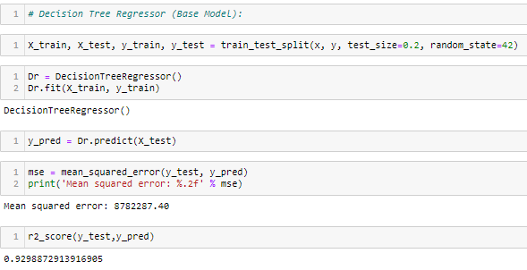
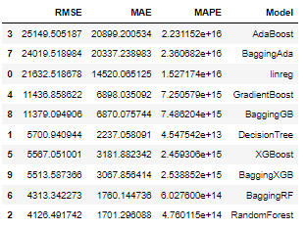
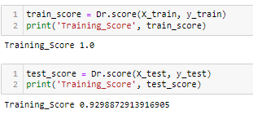
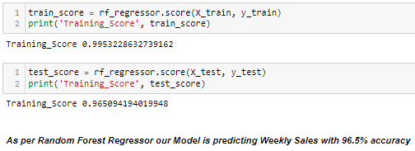
BASE MODEL
BEST FITTING REGRESSOR MODEL

Slide 10
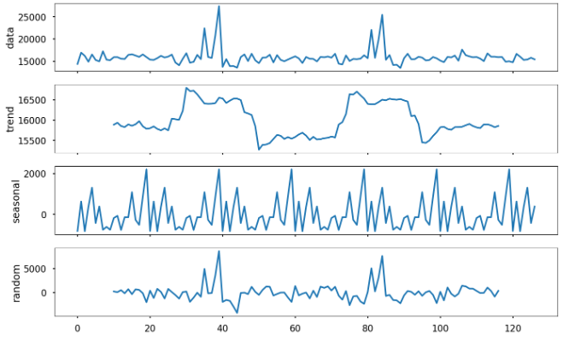
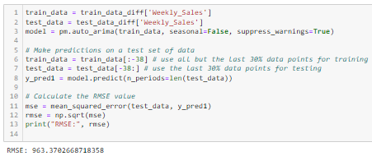
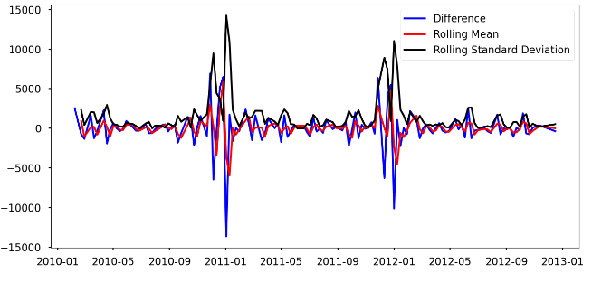
TIME SERIES ANALYSIS & BEST-FIT MODEL:
DECOMPOSING
Auto-ARIMA Model:
DIFFERENCING

Slide 11
CONCLUSION :
We inferred that our data leans towards Non-linear Regression, so we have Random Forest Regression model as our best base model.
At the end, we found best results for our data with Auto ARIMA Model. The best result for this project is 963 RMSE value.
RMSE is the model evaluation metric which we are using in our case because it not only calculates how close the prediction is to the actual value on average, but it also indicates the effect of large errors.

Slide 12
THANK YOU!

